Slide 1

ABC Call Volume Trend Analysis
By Sudhansu

Slide 2
AGENDA
Project Description
Approach
Tech-Stack Used
Insights
Result
Project hyperlink
Data cleaning : Jupyter notebook.ipynb
Jupyter notebook.pdf
Data visualisation : Tableau workbook
Tableau workbook.pdf

Slide 3

Project Description
Analyzing inbound calling team data of a company, to extract useful insights that can help in providing recommendations for manpower planning to reduce call abandonment rate and improve customer experience.
We are given with 23 days call dataset which includes various details such as the agent's name and ID, the queue time, the time of the call, the duration of the call, and the call status (whether it was abandoned, answered, or transferred).
The goal of the project is to attract, engage, and delight customers, turning them into loyal advocates for the business.

Slide 4
Approach
Downloaded and imported the dataset in Jupyter Notebook, performed data cleaning i.e. removing missing & invalid rows and handling outliers. Used Tableau a visualisation tool to draw graphs and finding insights. And finally drawn conclusions from insights and made recommendations
Tech-Stack Used
Software: Python 3.10.12, Tableau Desktop 2023.1.0
Version: Jupyter Notebook 6.4.6
Purpose: Data cleaning and visualization
I used Jupyter Notebook and Tableau to clean and visualize data because these tools are powerful and versatile. Python is a general-purpose programming language that can be used for a variety of tasks, including data cleaning and visualization. Jupyter Notebook is an interactive environment that makes it easy to write and run Python code.

Slide 5
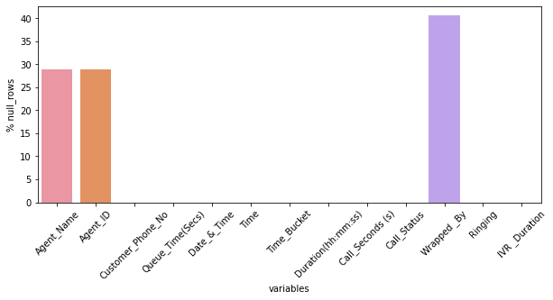
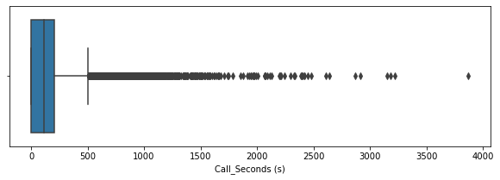
Data Cleaning
Agent_Name (28%), Agent_ID (28%), Wrapped_By (40%) columns have null rows.
all null rows of "Agent_Name" have null "Agent_Id" and call duration is 0 which is as expected
all rows with null Agent Name have call_status "abandon"
thus keeping all these values as it is, as it will not create any problem in our analysis.
droping "wrpped_by" column having 40% null rows and it is also no use in our analysis
Outlier values of call_durations beyond ~2500(41min) left as it is as they are valid values with just very high call duration and kept in mind while analysis.

Slide 6
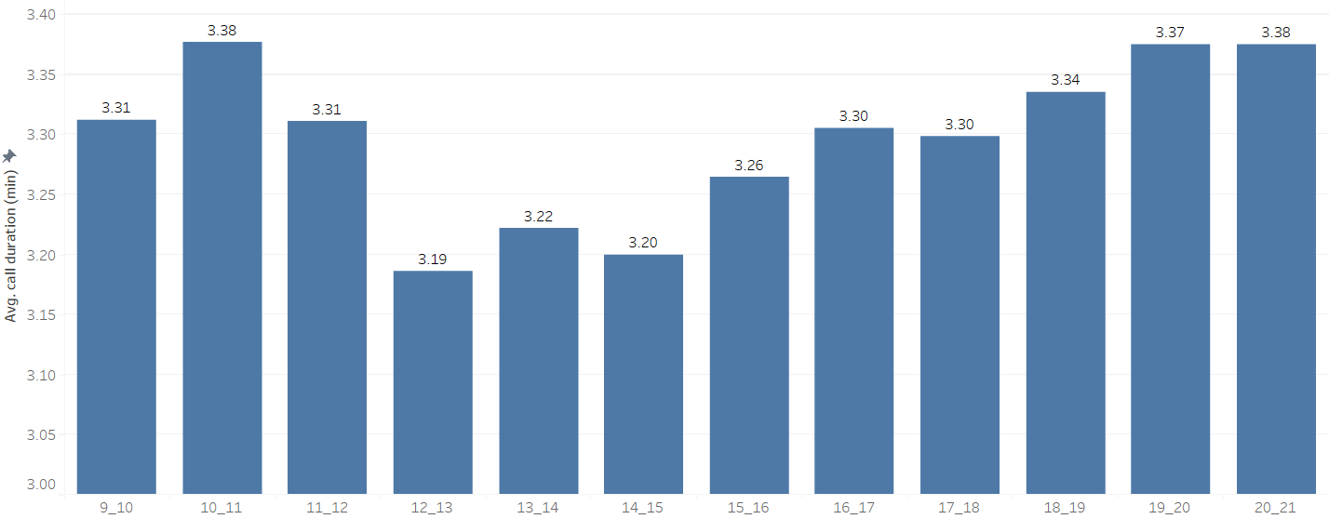
Insights: There is not much variation in avg. call duration, approx. 3 min for each time bucket
Average duration of calls for each time bucket(min)
*Average of call duration (min) for each Time Bucket. The marks are labeled by average of call duration (min). The data is filtered on Call Status, which keeps answered and transfer.

Slide 7
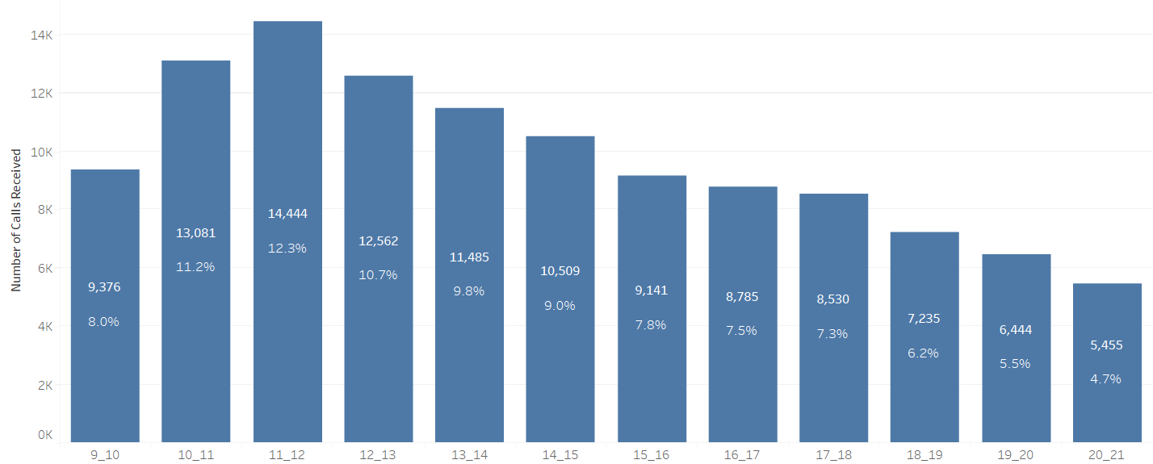
14,000 calls received in 11_12 time bucket within 23 days, 9am-12pm is the most busiest time slot
Number of calls received in each time bucket in 23 days
*Count of Customer Phone No for each Time Bucket. The marks are labeled by count of Customer Phone No and percentage distribution.

Slide 8
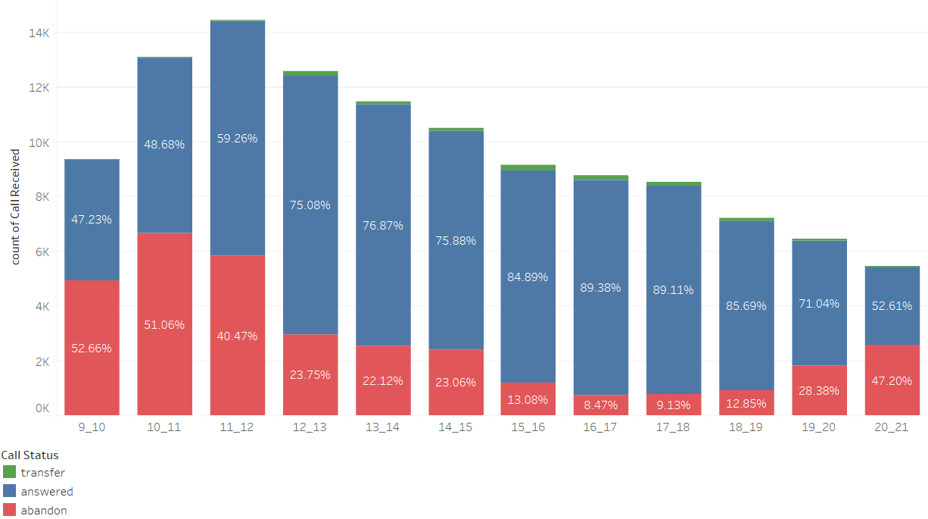
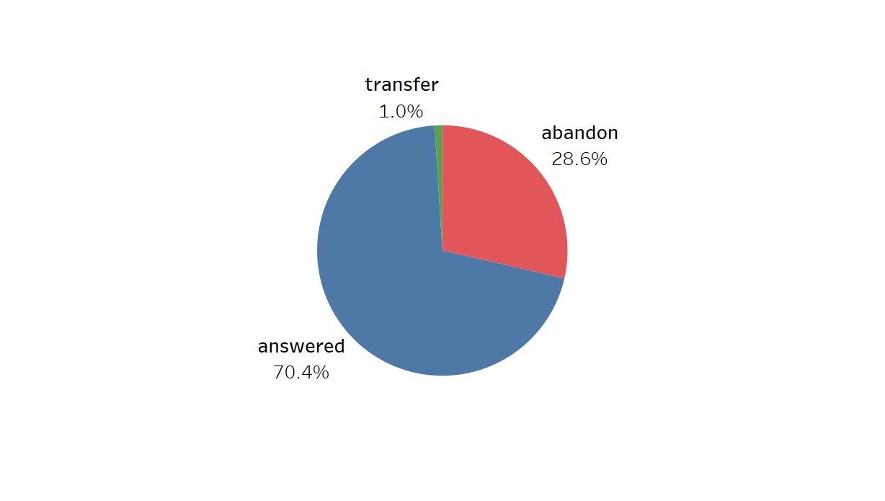
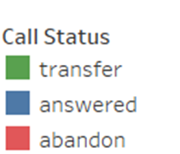
Manpower Planning
Call abandon rate is around 30%
9 am to 12pm slots have high abandon rate, require max manpower

Slide 9
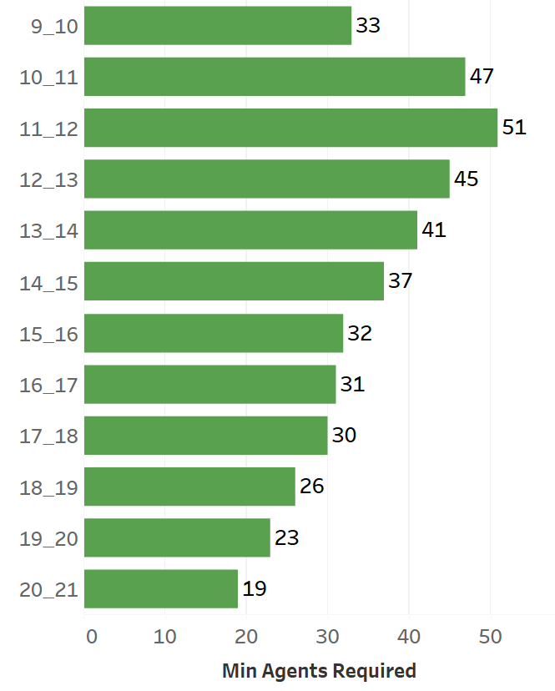
Minimum no. of agents required in each time bucket(from 9 am to 9 pm) to reduce the abandon rate to 10%
Actual working hour on calls with customers/users is 4.5hrs (60% of 7.5 hours) per day
avg. call duration = 198.6
an agent can answer avg. calls per day = 4.5 * 60 * 60 / 198.6s = 81 calls/day
Average calls an agent can answer in 1hr time bucket = 81/7.5hr = 11 calls/hr approx.
We calculated minimum agents required in each bucket to answer 90% call = "no_calls_recv"*0.90/11

Slide 10
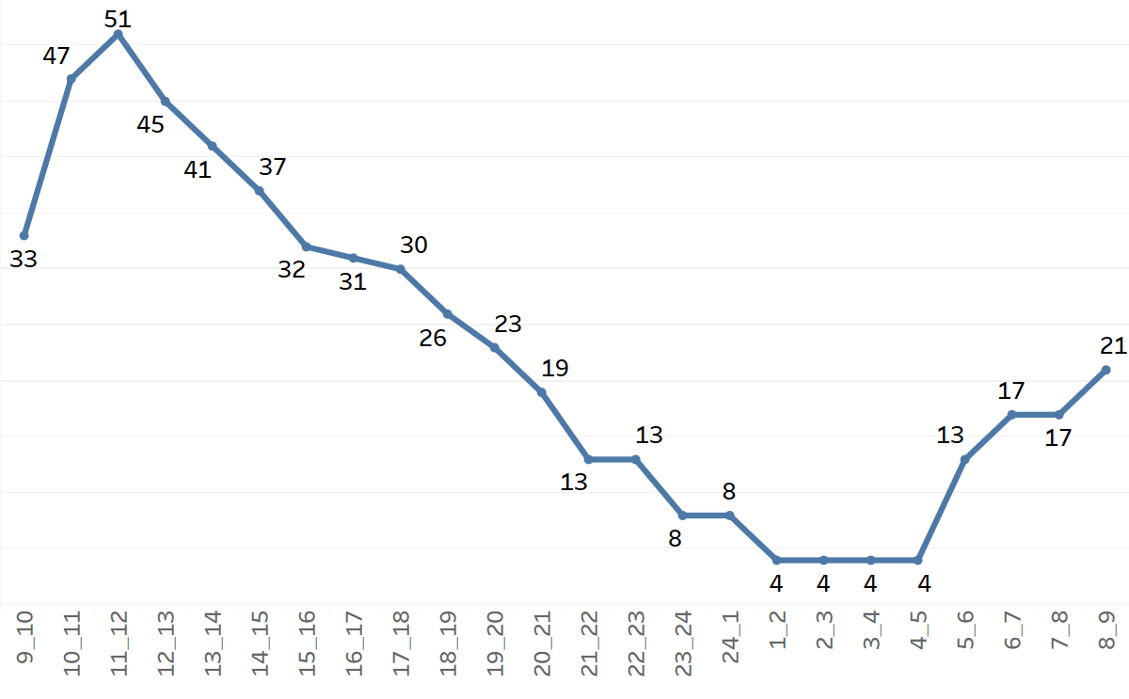
Manpower plan for each time bucket throughout the day, keeping the maximum abandon rate at 10%
Min agents required in each time bucket including night shift
Night Shift Manpower Planning
avg. calls/day in night shift = 30% of avg. calls/day 9am-9pm = 1527
Cal count of calls received by distributing total calls at night to different time bucket using prob. distribution.
We calculated minimum agents required in each bucket to answer 90% call = "no_calls_recv"*0.90/11

Slide 11
Results
Conclusions and recommendations :
9am-12pm slot received highest calls and also have the highest call abandoned rate company should use the man power planning in each time bucket and reduce it to 10%
Man power planning will help to manage the agents and ultimately reduce call abandonment rate and improve customer experience.
This will help to attract, engage, and delight customers, turning them into loyal advocates for the business.

Slide 12
Thank you

